Slide 1
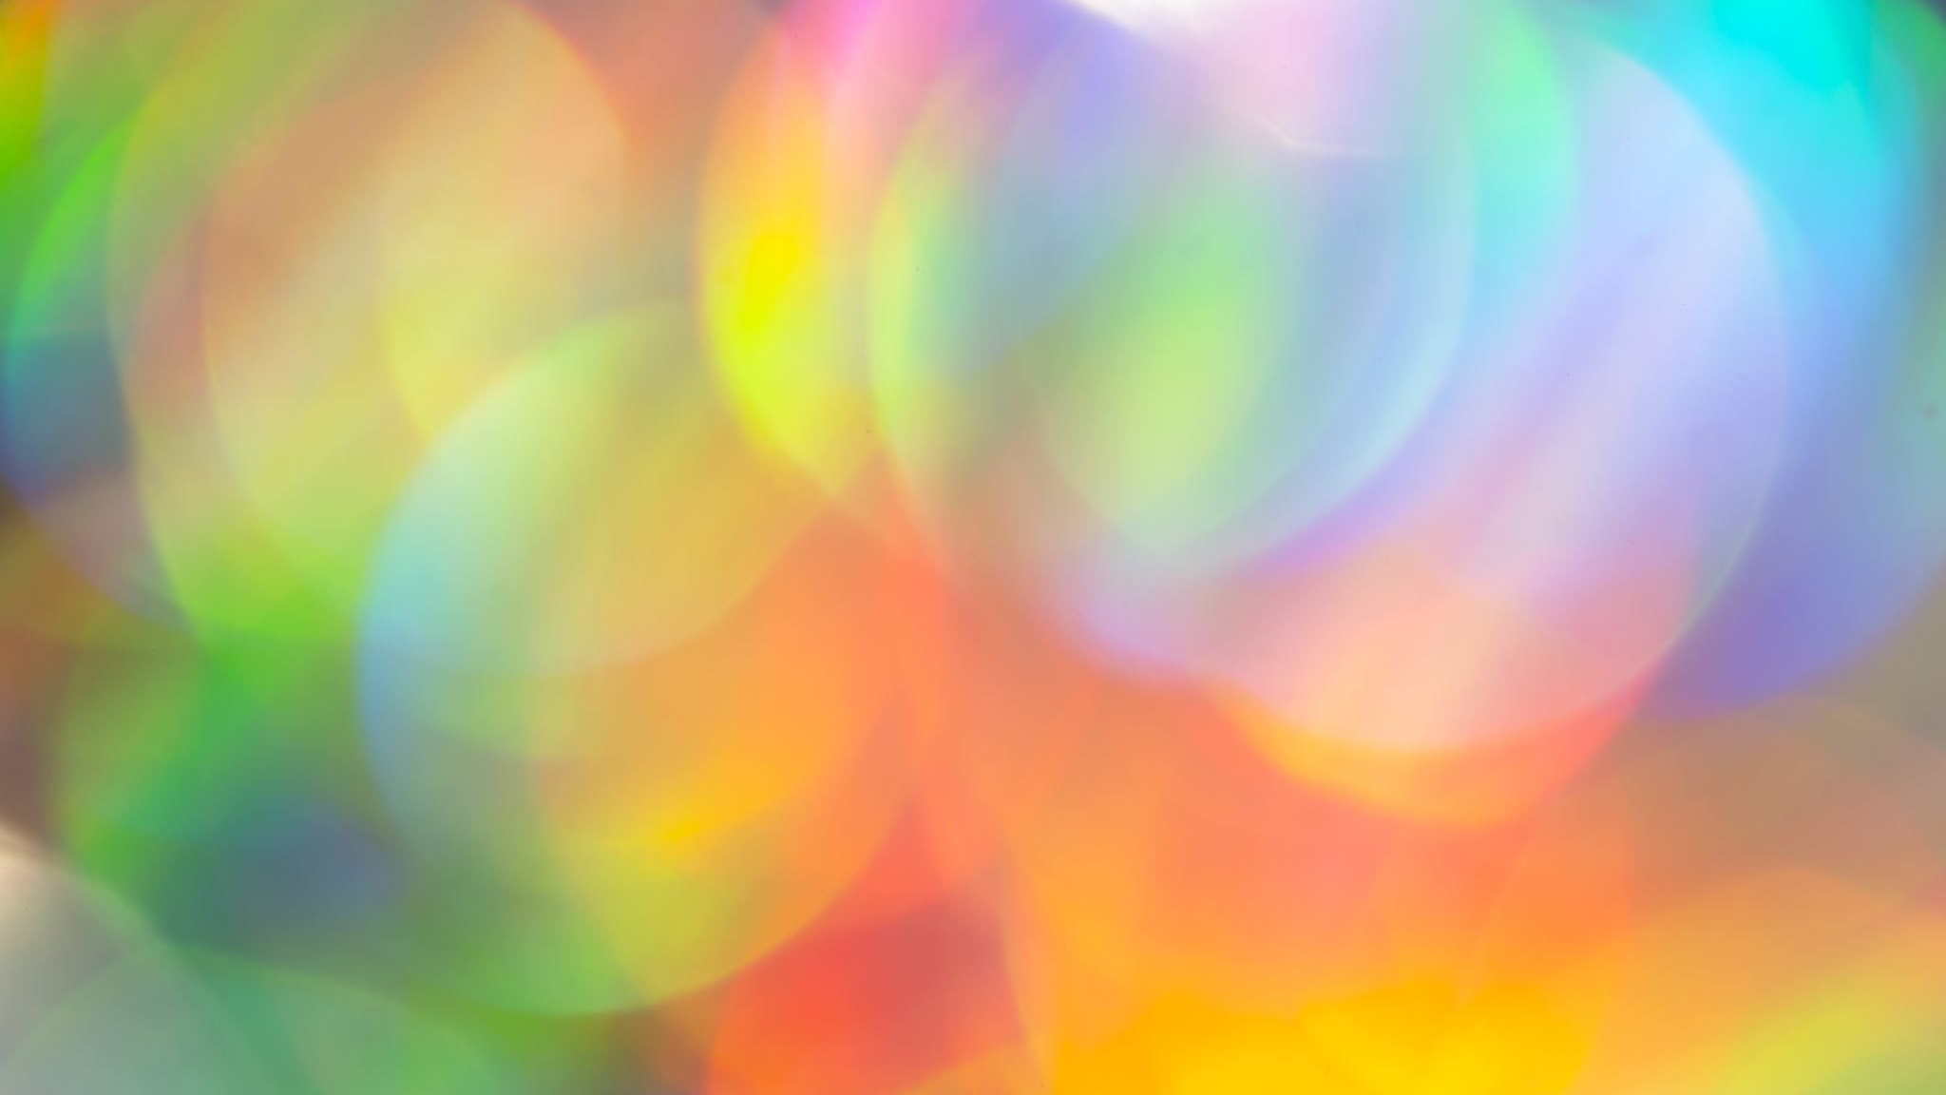
Digital 3D Portfolio
Michal Nickel (N1075587)

Slide 2
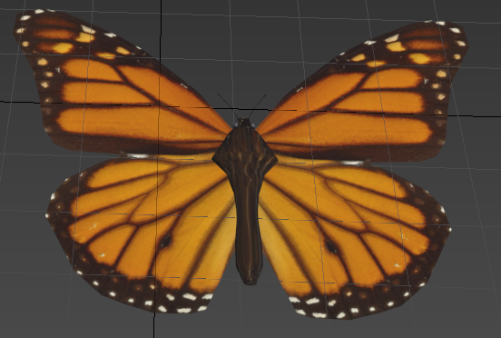
1. Butterfly (Animated)

Slide 3
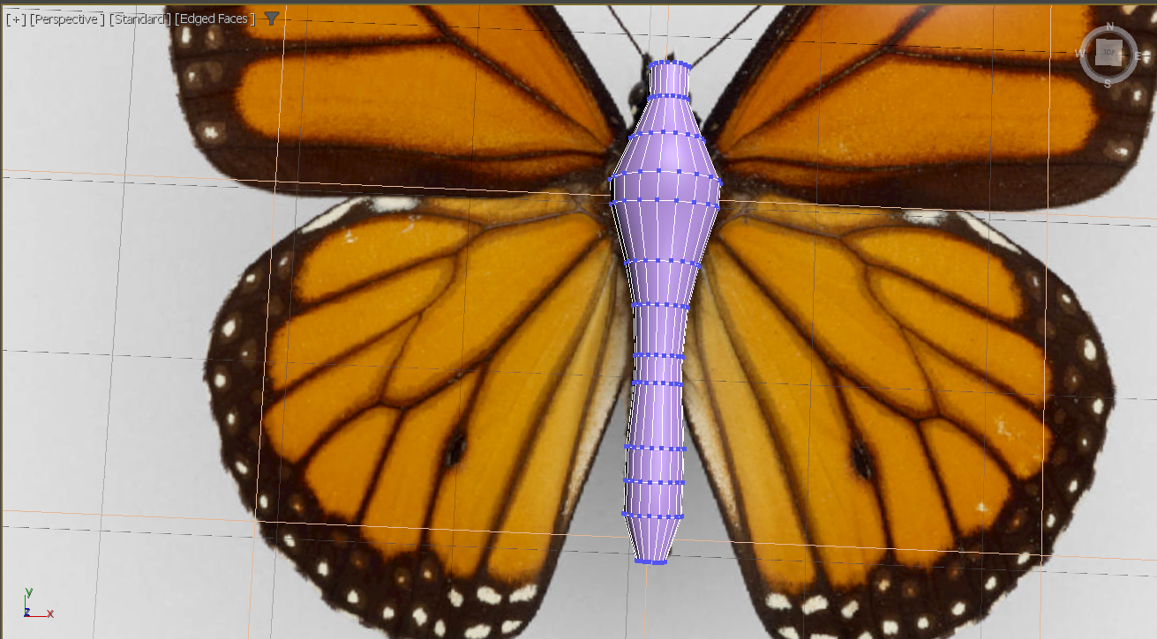
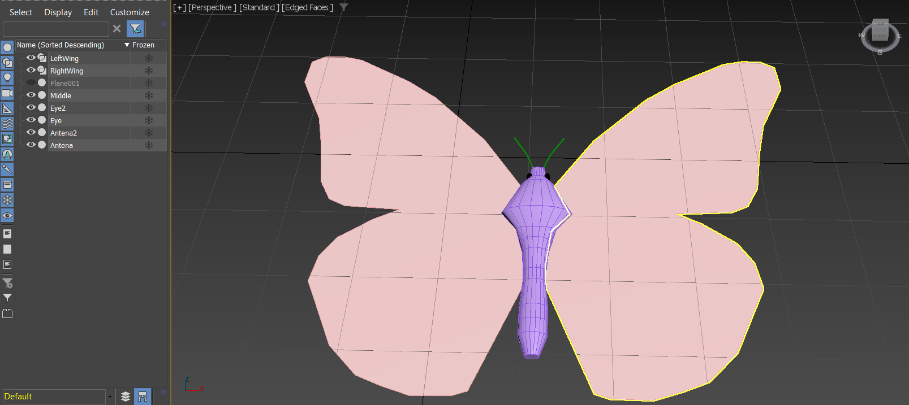
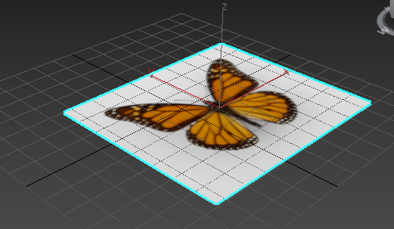
Butterfly Modelling
Firstly, I have created a plane with a simple butterfly image to be able to create an outline of the wing and make it into a shape. After that, middle of the butterfly was made by aligning the vertices of the cylinder with edit poly modifier to the image outline.
The pivot points were set to the middle of the butterfly to be able to give a smooth flapping animation of the wings. Then extra bits were added to the middle of the butterfly, such as the eyes and the antenna that would also move while the butterfly is moving.

Slide 4
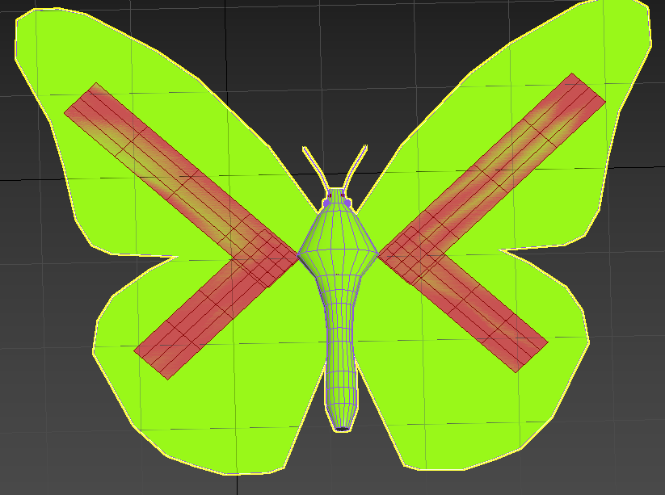
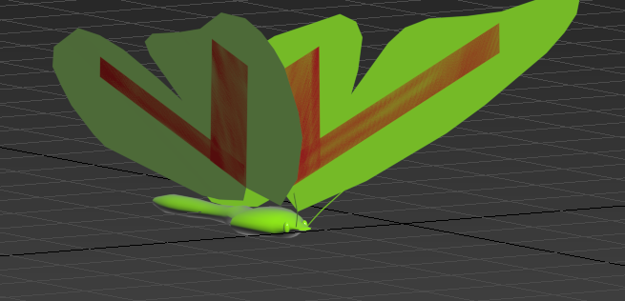
Butterfly Animation
I have then created a basic flying animation for the butterfly using the keyframes in 3DS Max. I have set up the bone structure for the butterfly (both wings, antenna, middle and middle-wing bones). After setting the pivot points, I have linked the bones together and added the skin modifier with the new bones. Slight adjustment to the envelope vertices in the middle wing bone allowed for me to move the wings back into position ready to be animated.
Every 10 frames, the butterfly's wings rise, and the antenna move up and to the side. Then at frame 20 the wings and antenna return to the original position. This cycle then repeats continuously giving the flying animation of the butterfly.
[See Additional Video for a better visualisation]

Slide 5
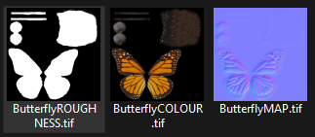
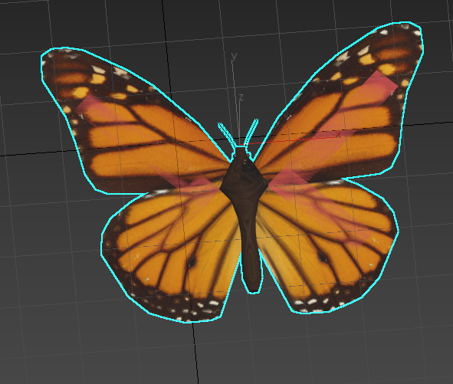
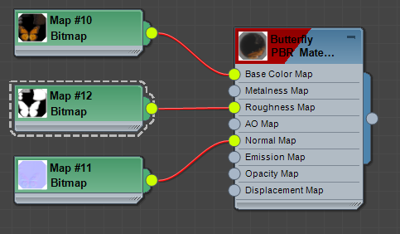
Butterfly Mapping
I have made the UV Maps for each part of the butterfly in 3DS Max and then created templates for the eyes, antenna, wings and the middle. All roughness values have been set to 1. Then in Photoshop I have create an image over the UV map templates so that all butterfly components have a different shade. Then I created the normal map for each to add a texture to the butterfly. Then you can see in the 3DS Max material editor, that I have used the normal map and base colour for each part of the model to give a final look which can be seen below.

Slide 6
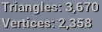
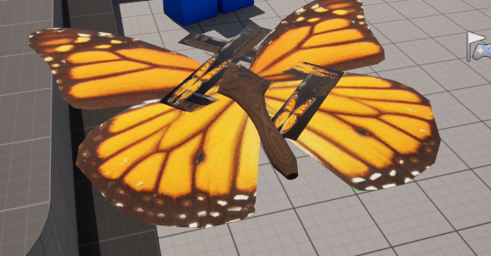
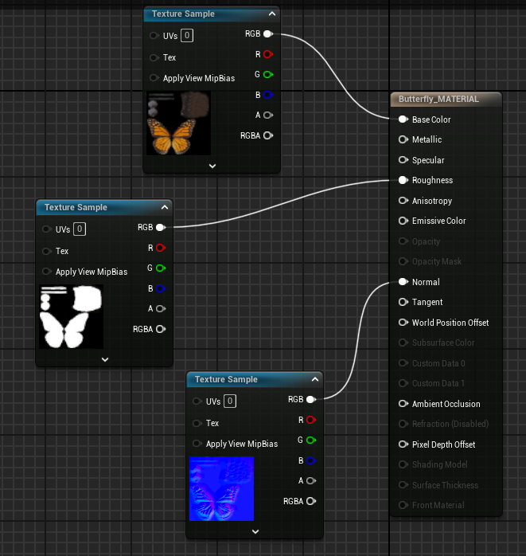
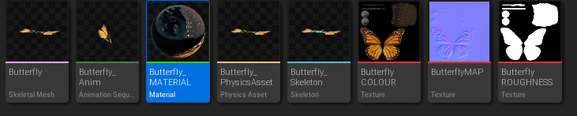
Butterfly in Unreal Engine 5
Firstly, I imported all the materials, textures and mesh into Unreal Engine 5 and set up the materials for the mesh. The base colour, roughness and normal map have also been added to the material to give the butterfly a realistic look. There is also a high of the range triangle, and vertices count which requires more resources to run. The butterfly was made in very high triangle count so that it can be very high quality inside the level.
There have been unsuccessful attempts at removing the wing bones in the blueprint using hide bone by name, however, it wouldn't work with 2 nodes.

Slide 7
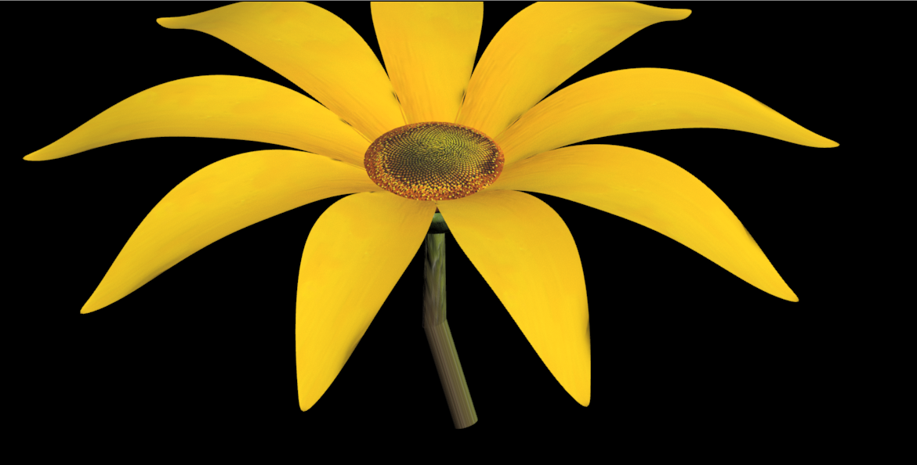
2. Sunflower

Slide 8
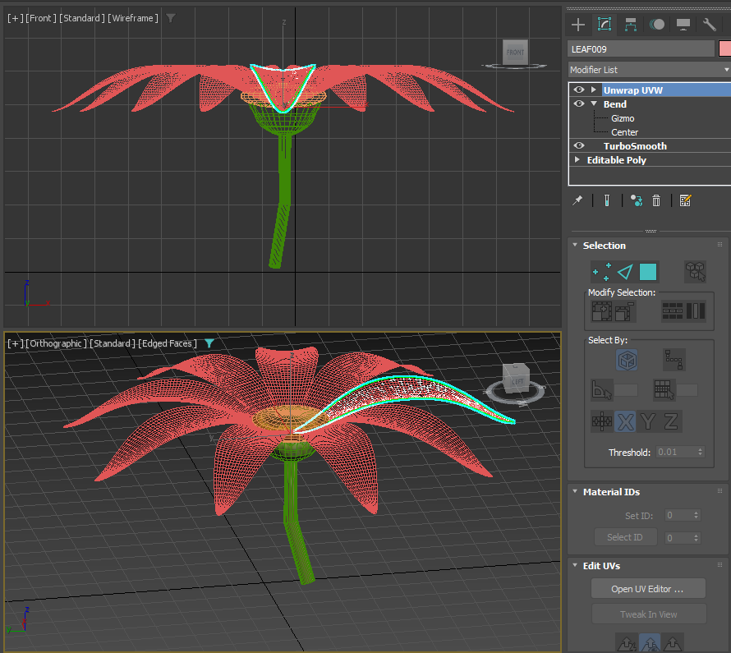
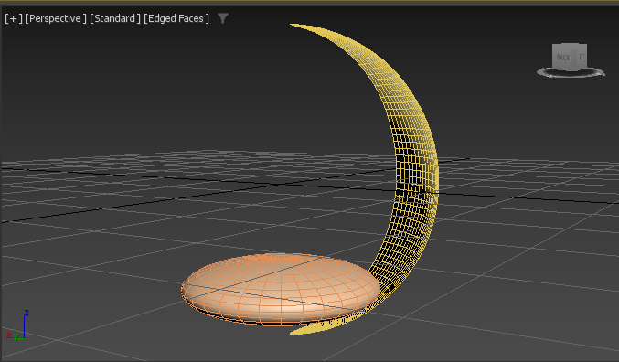
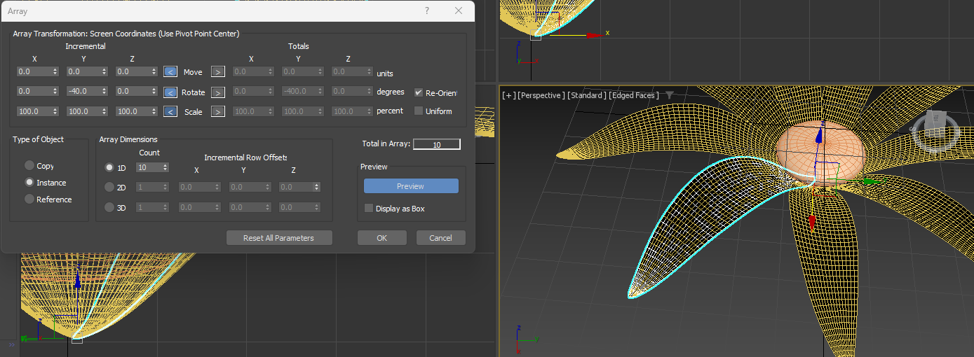
Sunflower Modelling
Sphere was created to represent the centre of the sunflower. Then was split 4 polygons wide from bottom to top of the shape. Shapes were scaled down and petals bent backwards to imitate a flower.
The pivot point for the leaf was set at the bottom, so when I used the array tool, I could easily duplicate the number of petals around that point.

Slide 9
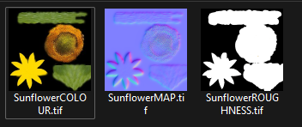
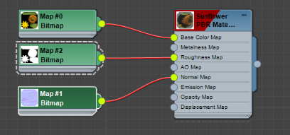
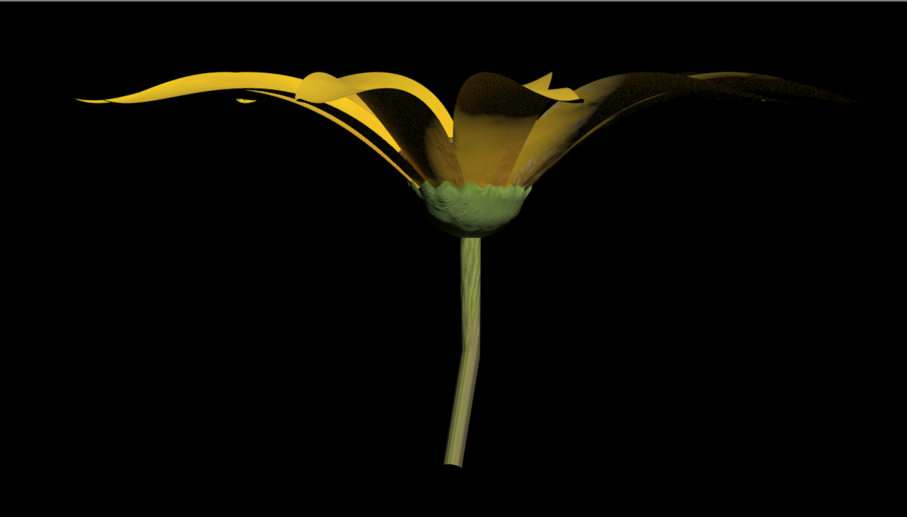
Sunflower Mapping
I have made the UV Maps for each part of the sunflower in 3DS Max and then exported each map as a template. I have used the templates for each and filled the templates with the images of sunflowers. One map was for the base colour in the material properties and the other was for the normal map to map the texture of the material to the sunflower model. Each of the flower elements have a slight roughness added in the material modifier to replicate a sunflower in real life.

Slide 10
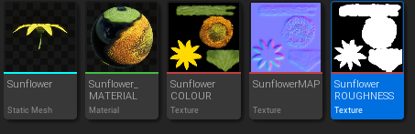
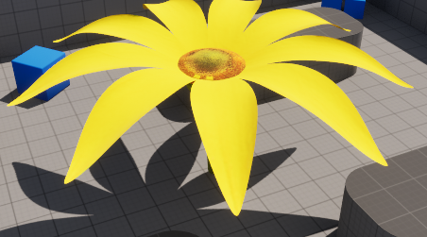
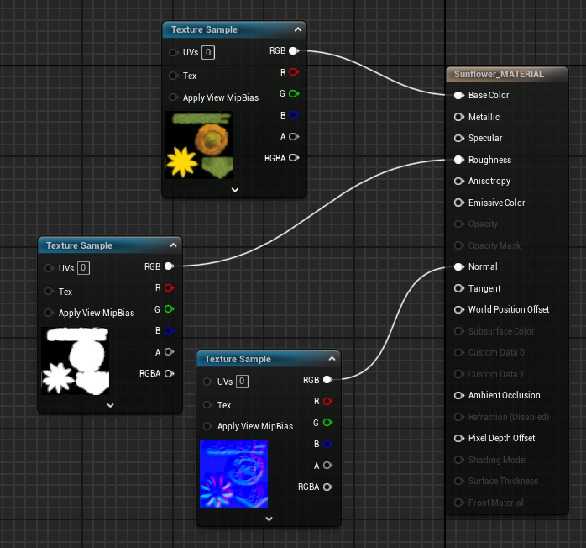
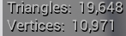
Sunflower in Unreal Engine 5
Firstly, I imported all the materials, textures and mesh into Unreal Engine 5 and set up the materials for the mesh. The base colour, roughness and normal map have also been added to the material to give the sunflower a realistic look. There is also a high of the range triangle, and vertices count which requires more resources to run. The sunflower was made in very high triangle count to be used to walk on top of in the level.

Slide 11
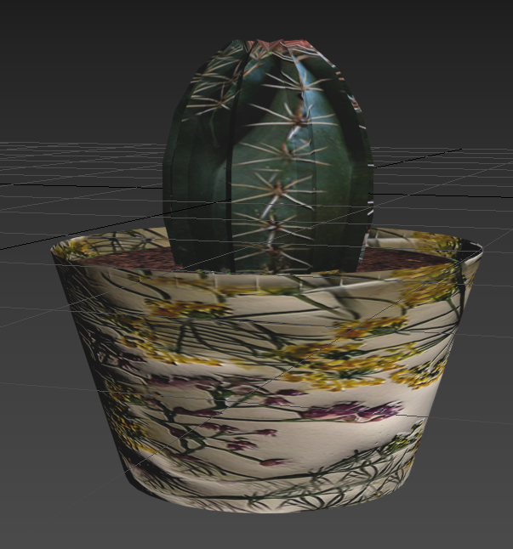
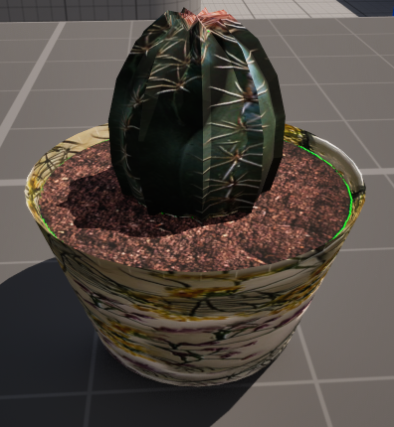
3. Cactus

Slide 12
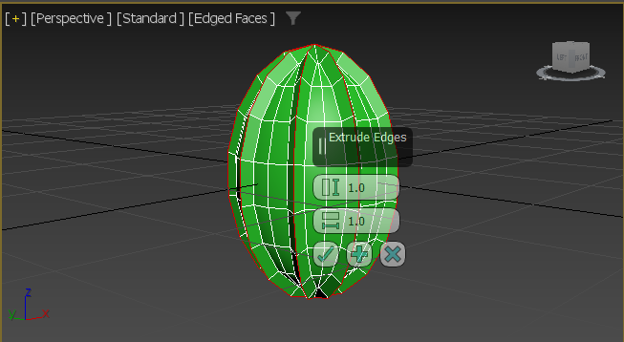
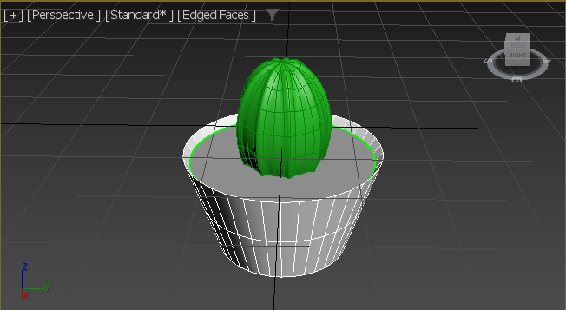
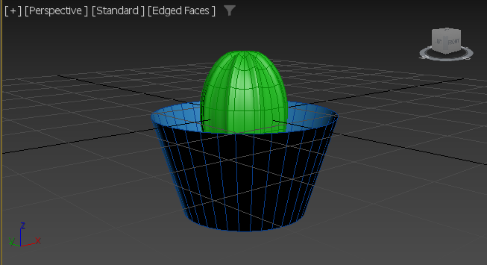
Cactus Modelling
When creating a small potted cactus, I used a sphere to create the shape of the cactus. After scaling it to have a tall oval shape, I extruded every 2 edges of the shape and scaled them outwards to give the cactus spiked edges. Then used the mesh smooth modifier to make it look smoother.
After this, I drew a line to create a curved potted shape using the lathe modifier. The normals were flipped, converted to editable poly and then shift scaled the top edges of the pot to give it some thickness. Lastly, I capped the inside of the pot and then separated that polygon so that it can be used for the soil inside.

Slide 13
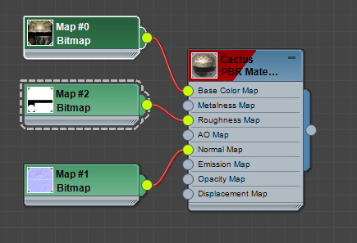
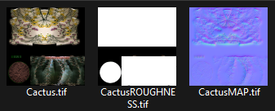
Cactus Mapping
I have made the UV Maps for each part of the cactus in 3DS Max and then created templates for the cactus, soil and the ceramic pot. All roughness values have been set to 1. There have been quite a lot of issues with the UV map template and aligning the parts of the cactus and pot. After a lot of trial and error, this was the best outcome for the images have been selected. With more time and a few adjustments to the template, it could be improved.

Slide 14
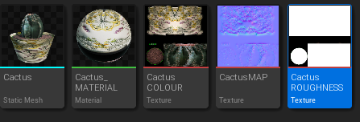
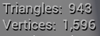
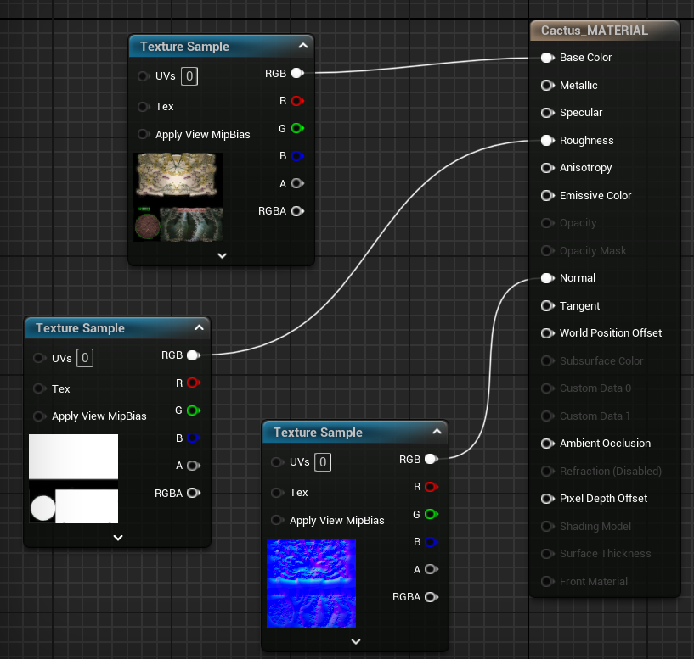
Cactus in Unreal Engine 5
Firstly, I imported all the materials, textures and mesh into Unreal Engine 5 and set up the materials for the mesh. The base colour, roughness and normal map have also been added to the material to give the cactus a realistic look. There is also a mid of the range triangle, and vertices count which would make it a fine in a high-density environment because it requires more resources to run. Therefore, it is more detailed.

Slide 15
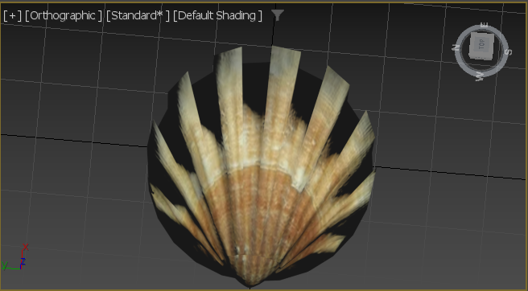
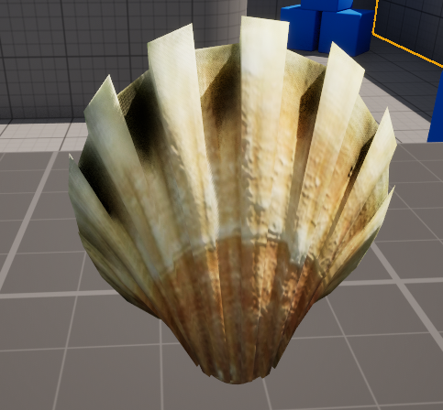
4. Seashell

Slide 16
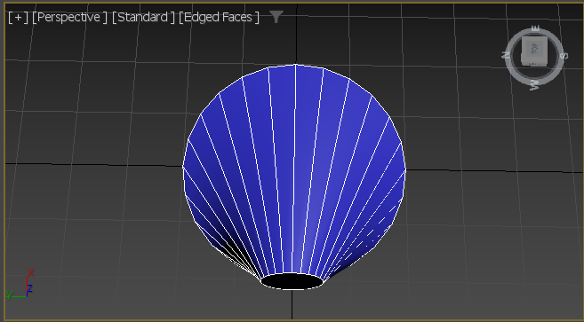
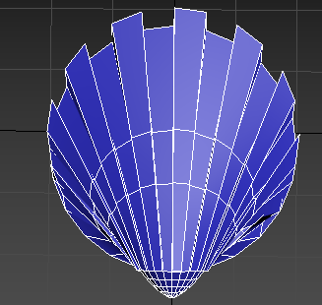
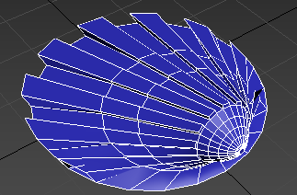
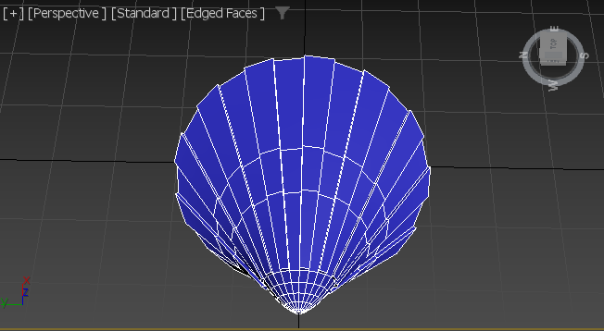
Seashell Modelling
To model a seashell, I made a small cone with a plat polygon on top and then using the edit poly modifier to move the top polygon back, rotate it to appear in the shape of a seashell. Then I insetted the tip of the polygon a couple of times to make it look smoother. The bevel modifier was used on the front part of the shell in an alternating pattern to give the look of a seashell. Then the bottom polygon of the shell was moved towards the tip slightly to make the bottom part which is sticking out.

Slide 17
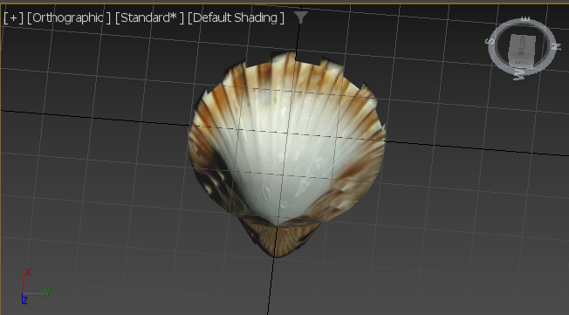
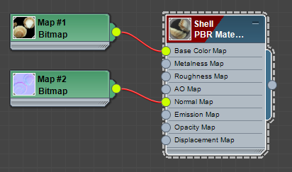
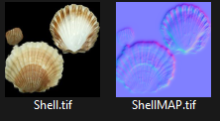
Seashell Mapping
I have made the UV Maps for each part of the seashell in 3DS Max and then created templates for it. The roughness values have been set to 1 to help replicate the hard stone texture of a shell. When unwrapping the shell, I had to separate the front of the shell with the tip and the back so that I could accurately use the base colour map and the normal maps onto the materials editor.
Then I created the base map using an image of the front and back of a shell found on the internet. Then a normal map for each to add a texture to the seashell. Then you can see in the 3DS Max material editor, that I have used the normal map and base colour for each part of the model to give the shell a realistic look.

Slide 18
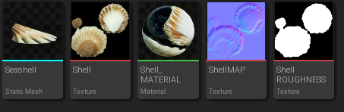
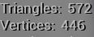
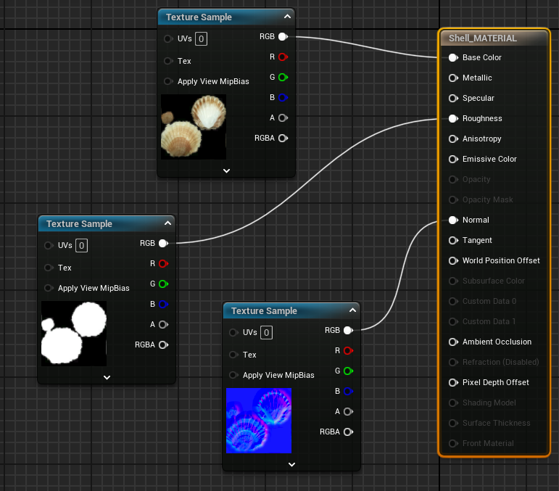
Seashell in Unreal Engine 5
Firstly, I imported all the materials, textures and mesh into Unreal Engine 5 and set up the materials for the mesh. The base colour, roughness and normal map have also been added to the material to give the seashell a realistic look. There is also a low triangle, and vertices count which would make it a good in a high-density environment because it requires less resources to run.

Slide 19
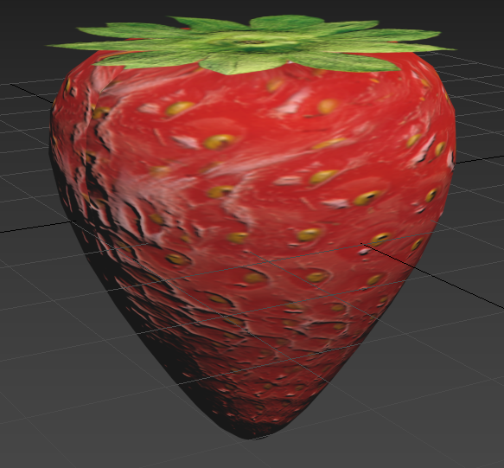
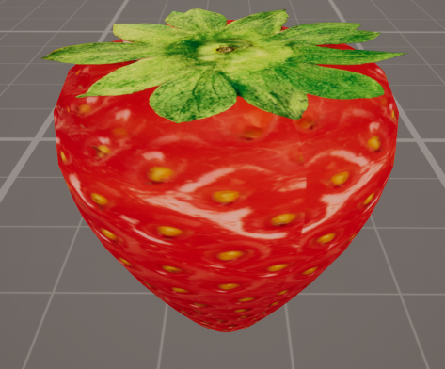
5. Strawberry

Slide 20
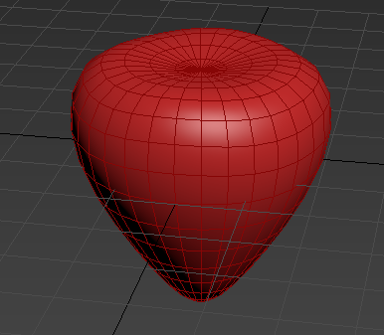

Strawberry Modelling
To model a strawberry in 3DS Max, I have scaled a sphere down and then used the FFD 4x4x4 modifier to split the shape into 4 segments. From this, it made scaling easier. The bottom was scaled down, the middle scaled outwards and the top 4 vertices moved down to give the strawberry a small indent at the top. Then all edges were connected to give a diamond cross-section on the side of the strawberry.

Slide 21


Strawberry Mapping
I have made the UV Maps for each part of the strawberry in 3DS Max and then created templates for it. The roughness values have been set to 1. When unwrapping the leaves, I had to create a base map, normal map and opacity map so that the image could be used transparently on top of the strawberry.
Then I created the base map using an image of a strawberry and the leaves. Each of these have their normal map and the leaves also have their opacity map to add transparency to the area in black.

Slide 22



Strawberry in Unreal Engine 5
Firstly, I imported all the materials, textures and mesh into Unreal Engine 5 and set up the materials for the mesh. In the materials editor, I have enabled opacity of the strawberry material so that the leaves on top can become transparent. The base colour, roughness and normal map have also been added to the material to give the strawberry a realistic look. There is also a low triangle, and vertices count which would make it a good in a high-density environment because it requires less resources to run.

